Slide 1

ORDER_BUZZ
OUR TEAM
KM.FARHAND FOUSIA- (24KB1A3049)
K.HARSHITHA -(24KB1A3046)
P.RENUKA -(24KB1A3086)

Slide 2


INTRODUCTION
"Streamlining customer orders with efficient online and offline modes, enhancing the overall coffee shop experience."
Online Ordering with UPI Payment
Offline Ordering with Table Booking and Multiple Payment Options
Efficient Order Management System
User-Friendly Interface with Menu-Driven Options

Slide 3
OBJECTIVE
To create a menu-driven coffee & cafeteria order system C supports:
Online and offline ordering
Table booking
Item selection from a menu
Simple payment system
Order management using stack

Slide 4
CONCEPTS USED &WHERE THEY ARE PPLIED
Concept what it means where its used
1.Stack(Data structure) A Last-in-first -out used in push(),display()
structure used to store and clear Orders()
and manage orders. functions.
2.Structures(struct) Used to group related Stack structure is defined
data together to manage the list of order
3.Functions A block of code that Functions like online order
preforms a specific task Offline Order(), display
helps in modular program. menu() etc.

Slide 5
Concept what it’s means where it’s Used
4.Control if, switch, while used in main(),get Order choice()
statements for control the and order-taking logic
flow of the program.
5.String and input used to store customer details f gets() and string copy are used in
handling and order names. name phone and address input.
6.Constants with used to set fixed values for price value and stack size are define
#define prices and limits. the top .

Slide 6
SOURCE CODE
https://github.com/20252507/HRF-ORDER_BUZZ/commit/ea7857f11f9f5789a45728669991733daa7be869

Slide 7
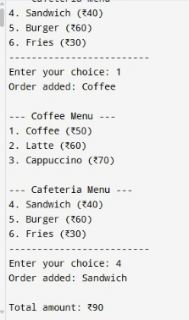
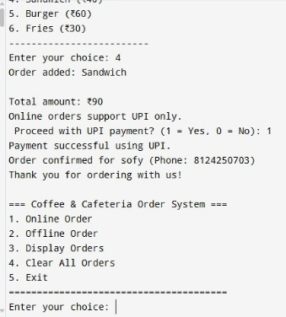
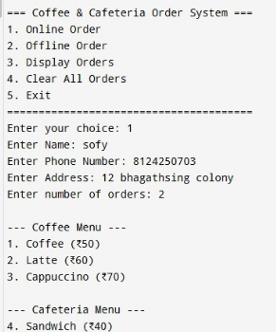
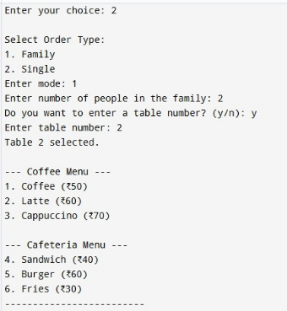
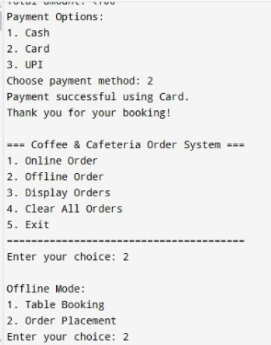
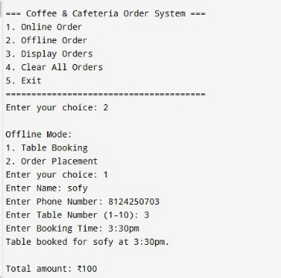
Output

Slide 8
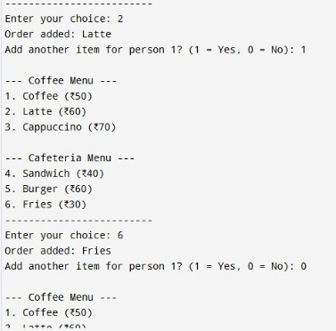
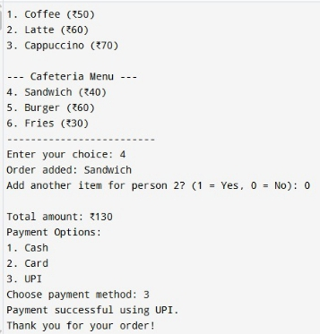
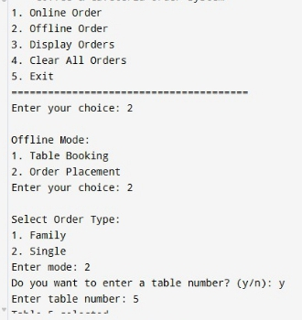
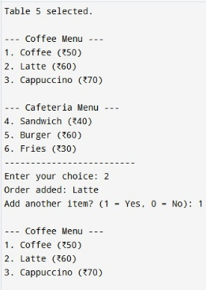
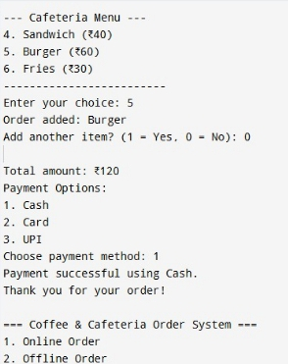
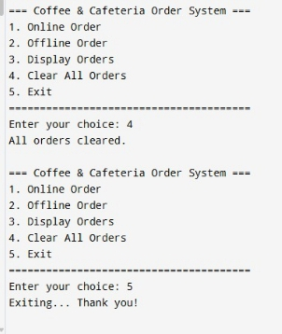

Slide 9


CONCLUSION
The Cafeteria Ordering System project successfully developed a user-friendly and efficient system, enhancing customer experience and streamlining operations.

Slide 10
FUTURE ENHANCEMENTS
Store orders in file - So data is not lost when the program exits.
Show detailed bill - List all items with prices and total.
Add discounts or coupon codes.
Add delivery time estimation for online orders
Use structures for orders - To store item name and price together.
Add user login (Admin/Customer) - For better control and reporting.

Slide 11


Any queries and suggestions

Slide 12


THANK YOU

